Slide 1
Building a Linear Regression Model

Slide 2
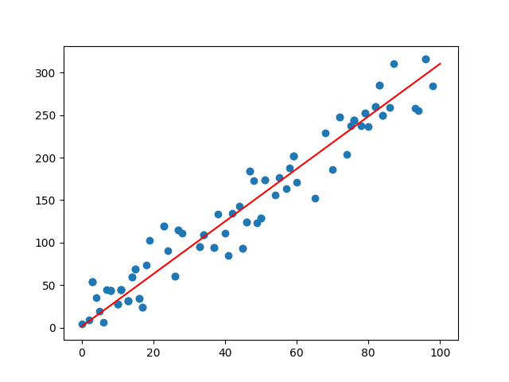
What is Linear Regression?

Slide 3
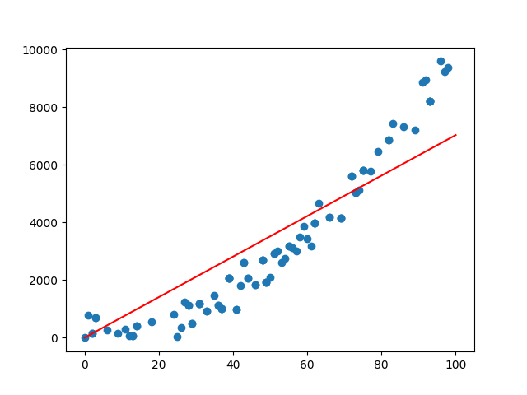
When Does it Not Work?

Slide 4
Developing the Model

Slide 5
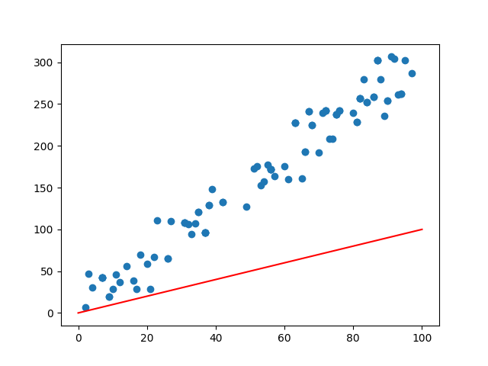
Make a Guess
y = wx + b
w is a “weight”
b is a “bias”
y = 1x + 0

Slide 6
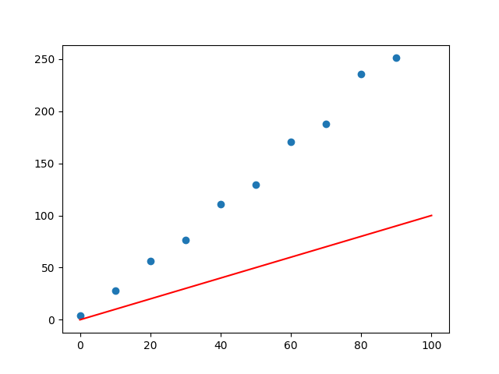
Devise a Cost Function
Cost function should
Be higher for worse guesses
Be lower for better guesses (0 for perfect fit)
F(weight, bias, X, Y) = Cost
F(w, b, X, Y) = C
Total average error
n
F(w, b, X ,Y) = 1/n Σ Yi - (wXi + b)
i = 1
MSE (Mean Squared Error)
n
F(w, b, X ,Y) = 1/n Σ (Yi - (wXi + b))^2
i = 1

Slide 7
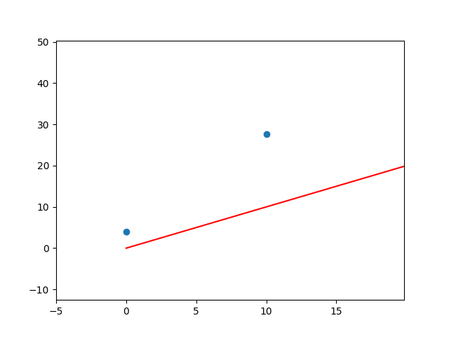
Calculating the cost for a single point:
F(w,b,x,y) = (y - (wx + b))^2
= (30 - (1*10 + 0))^2
=(20)^2 = 400
Derivative with respect to ‘w’:
d/dw F(w,b,x,y) = 2*(y - (wx +b)) * -x
= -2x(y - (wx+b))
d/dw F( w = 1, b = 0, x = 10, y = 30) = -2 * 10(30-(1*10 + 0)) = -20(20) = -400 = Gradient
This means that, for a small increase in w, say 0.001, the cost will decrease 400 fold, say by 0.4.

Slide 8
Cost Function Derivatives
Cost Function:
n
C(w, b, X ,Y) = 1/nΣ (Yi - (wXi + b))^2
i = 1
Cost Function Derivatives:
n
d/dw F(w,b,x,y) = 1/nΣ-2Xi(Yi - (wx+b)) = “wGradient”
i = 1
n
d/db F(w,b,x,y) = 1/nΣ-2(Yi - (wXi+b)) = “bGradient”
i = 1
*Using proper terminology, a “gradient” is a vector containing each weight’s derivative of the cost function. It points in the direction of steepest ascent.

Slide 9
Improve Guess
Cost Function:
n
C(w, b, X ,Y) = 1/nΣ (Yi - (wXi + b))^2
i = 1
Cost Function Derivatives:
n
d/dw F(w,b,x,y) = 1/nΣ-2Xi(Yi - (wx+b))
i = 1
n
d/db F(w,b,x,y) = 1/nΣ-2(Yi - (wXi+b))
i = 1

Slide 10
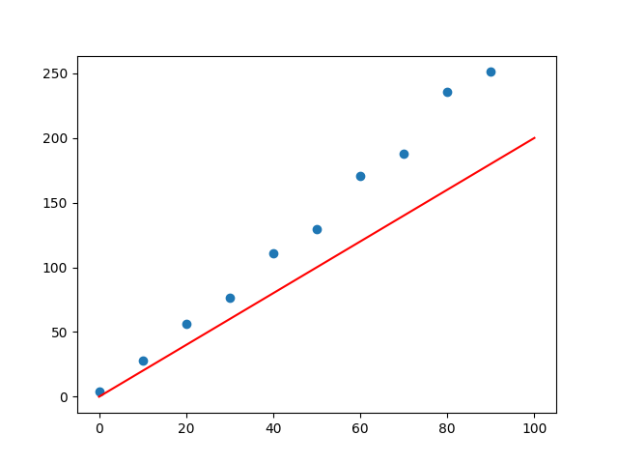
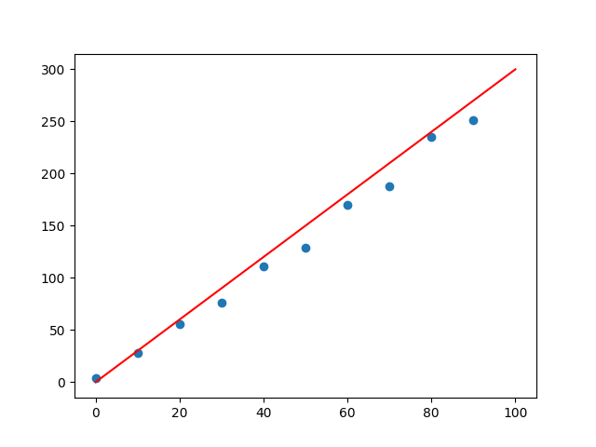
Iterate
y = 2x + 2
y = 3x + 1

Slide 11
We are done!
Live coding Google Colab: https://colab.research.google.com/drive/1rOH4MCGW6vW72OHFG5RSaEu6OrWltO44?usp=sharing

